Slide 1

Recogito | RISE & SHINE Workshop
Rainer Simon, AIT @aboutgeo

Slide 2
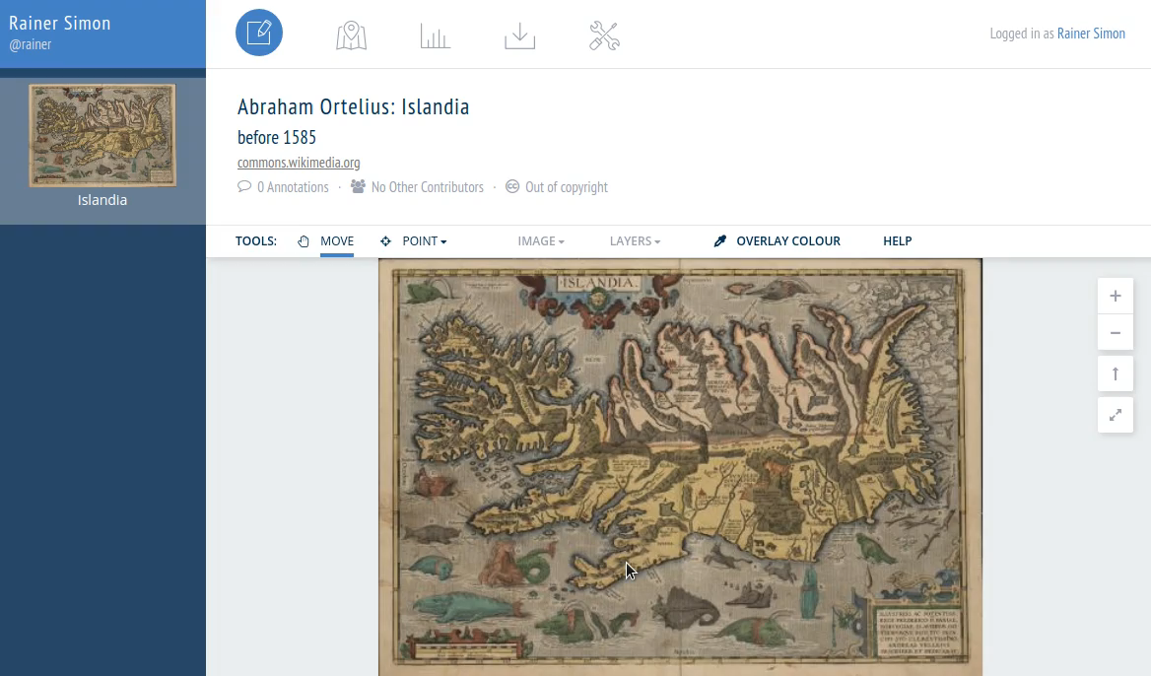
What is Recogito?
Web-based annotation tool for text and images
“Semantic annotation”
Open source software
Developed by the Pelagios Network, an international Humanities Linked Open Data initiative
https://recogito.pelagios.org

Slide 3
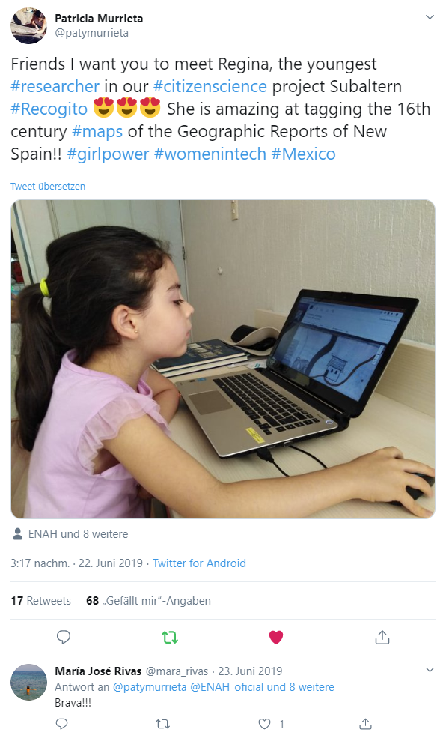



What is Recogito?

Slide 4
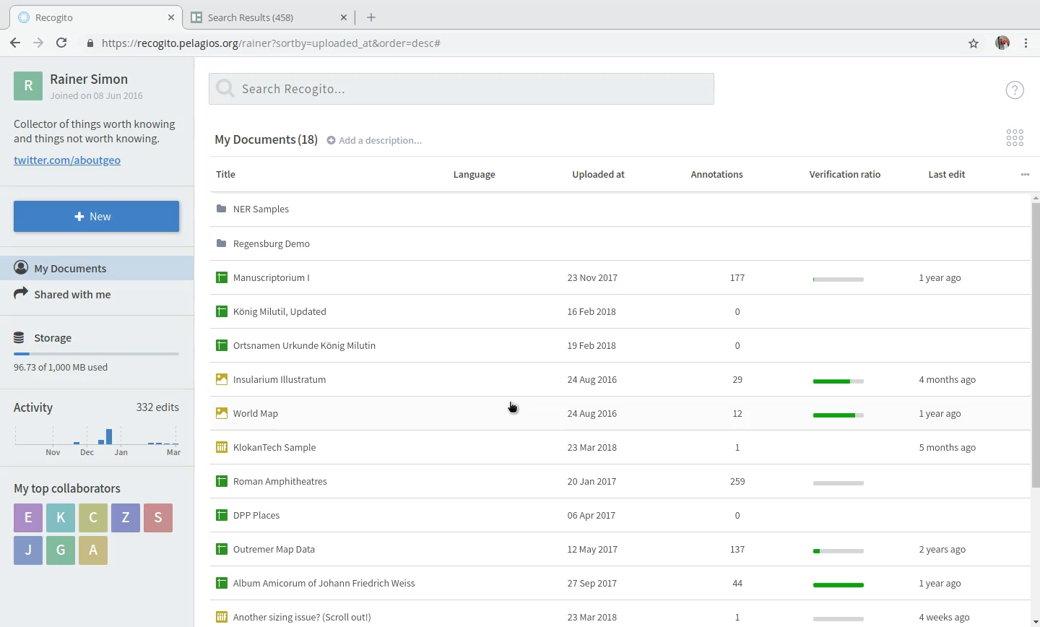

Slide 5
Importing directly from the SHINE API

Slide 6
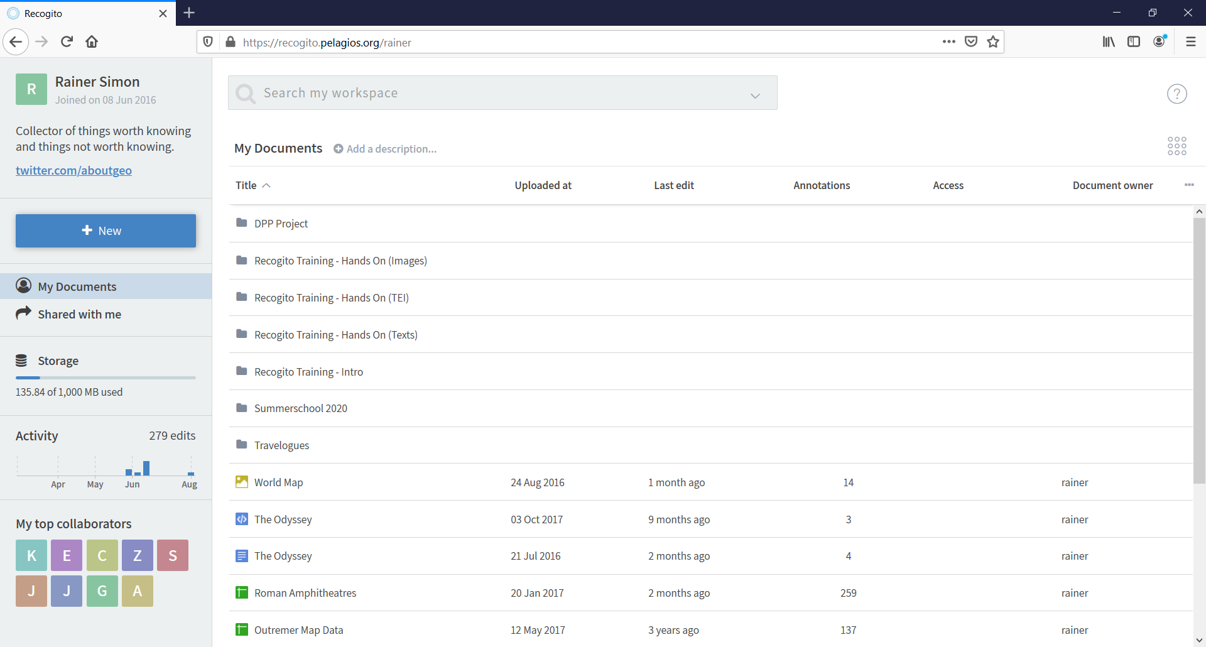

Slide 7
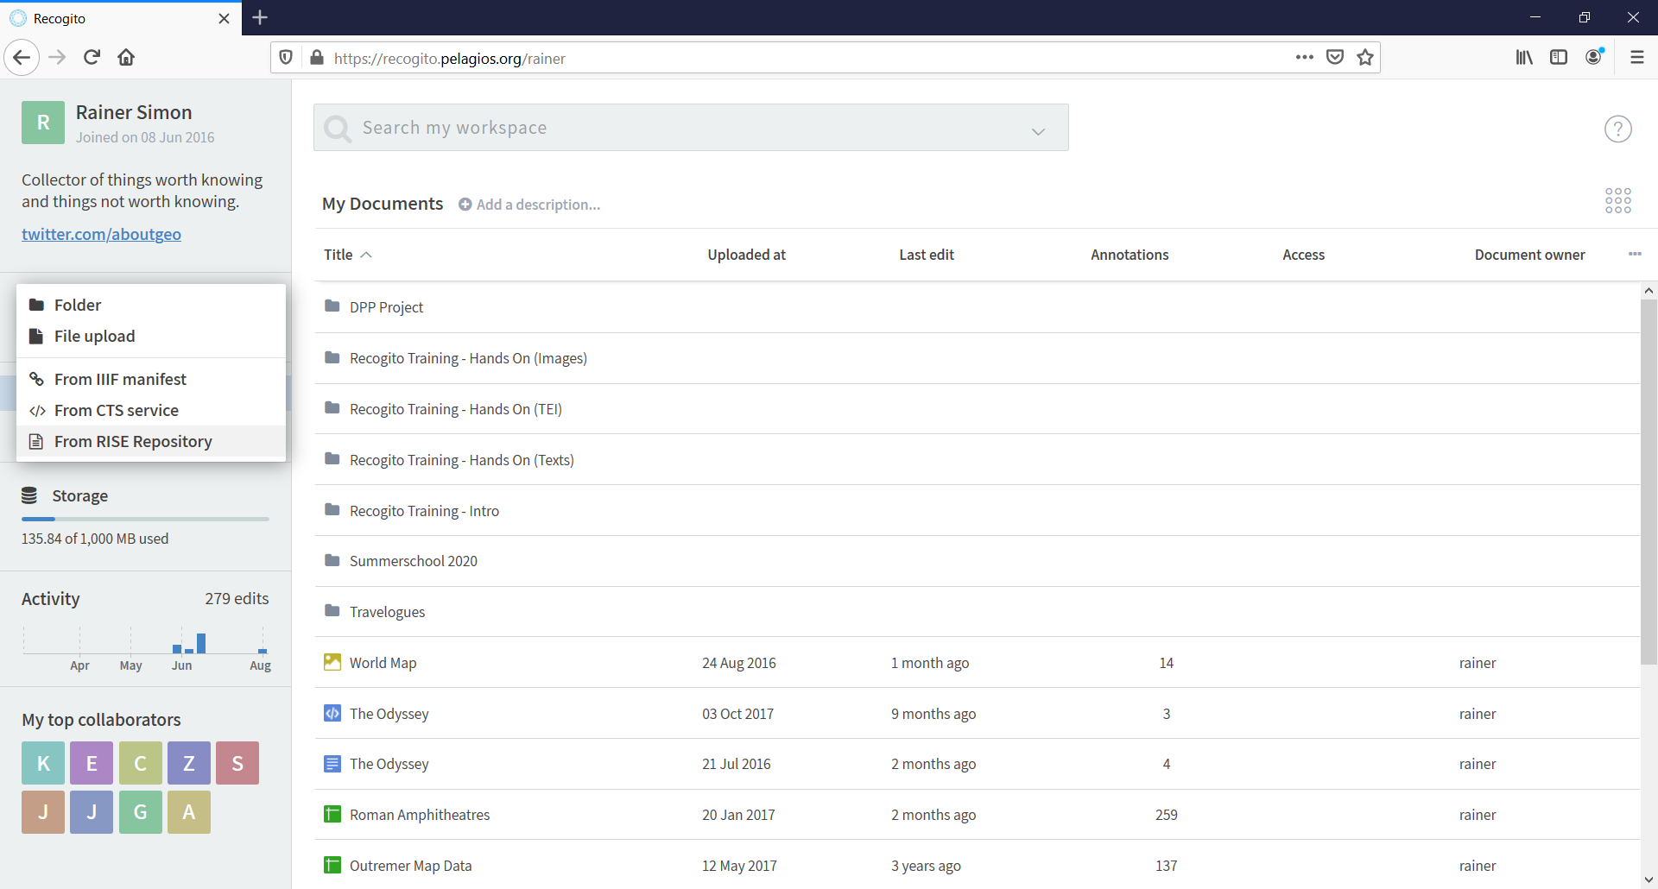

Slide 8
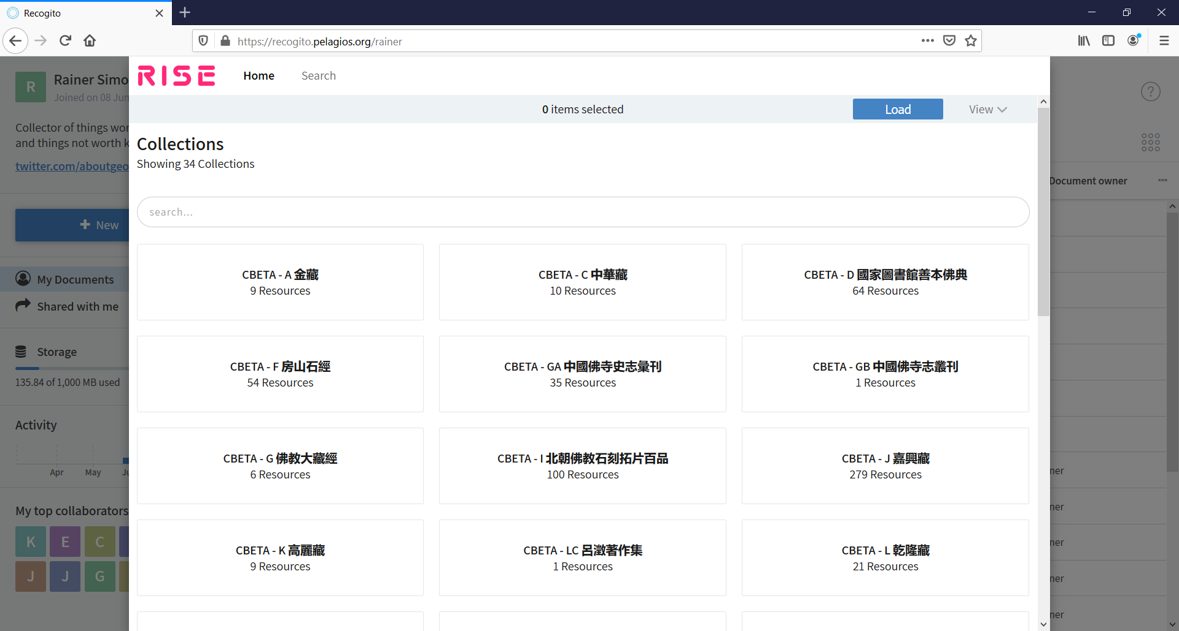

Slide 9


Implementation in Recogito
Recogito workspace UI is a React application https://github.com/pelagios/recogito2-workspace-frontend
https://www.npmjs.com/package/react-shine-api
Many thanks to Dean Barker, DBRsoftware.com

Slide 10
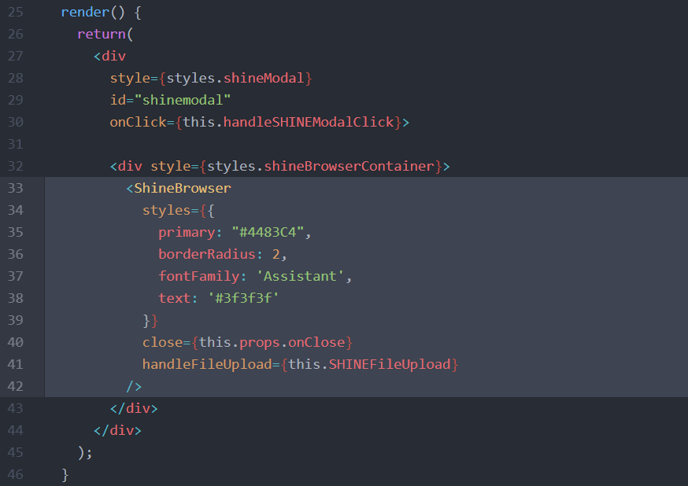
Implementation in Recogito

Slide 11
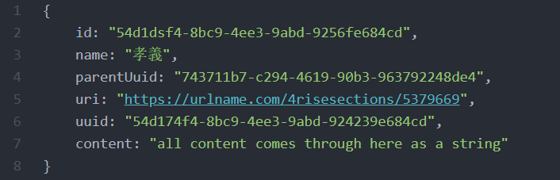
Implementation in Recogito

Slide 12
Recogito + SHINE API: Benefits
Working with content from RISE is seamless in Recogito
Originally, Recogito has been rooted strongly in the Classics community
RISE/SHINE integration is an opportunity for us to reach new audiences

Slide 13


Learn more…
The best way to learn about Recogito is to try it!
10 minute tutorial: http://recogito.pelagios.org/help/tutorial
Source code & self-installation: http://github.com/pelagios/recogito2
Project website: http://commons.pelagios.org
Grateful Acknowledgement to the Andrew W. Mellon Foundation and all @PelagiosNetwork Partners

